Slide 1


Intention and
Motor Representation
in Joint Action
s.butterfill@warwick.ac.uk

Slide 2

Intention and Motor Representation in Joint Action
s.butterfill@warwick.ac.uk

Slide 3
premise:
Social motor representation enables joint action
question:
Does social motor cognition also play a role in explaining what joint action is? [Yes]
challenge:
How could social motor representation and shared intention harmoniously contribute to joint action?
Notes:
As a philosopher I’m going to start with an empirically controversial premise.
I don’t think this premise has been established, but I do think it’s a reasonable bet.
I’ll try to explain the premise in more detail in a moment. But first let me outline where I’m going with this.

Slide 4
premise:
Social motor representation enables joint action
question:
Does social motor representation also play a role in explaining what joint action is? [Yes]
challenge:
How could social motor representation and shared intention harmoniously contribute to joint action?
Notes:
Need some kind of introduction

Slide 5
premise:
Social motor representation enables joint action
question:
Does social motor representation also play a role in explaining what joint action is? [Yes]
challenge:
How could social motor representation and shared intention harmoniously contribute to joint action?
Notes:
Let me start by explaining the premise.

Slide 6
premise:
Social motor representation enables joint action
question:
Does social motor representation also play a role in explaining what joint action is? [Yes]
challenge:
How could social motor representation and shared intention harmoniously contribute to joint action?
Notes:
First, what do I mean by *social* motor representation.
A motor representation if it concerns an action which is not one’s one or, in the case of joint action, not entirely one’s own.
It is uncontroversial that social motor representations exist.
The controversial part of the premise is the claim that such representations can enable joint action.

Slide 7
premise:
Social motor representation enables joint action
question:
Does social motor representation also play a role in explaining what joint action is? [Yes]
challenge:
How could social motor representation and shared intention harmoniously contribute to joint action?
Notes:
I should say, by the way, that I’m not suggesting that social motor representation is involved in every joint action.
Perhaps some joint actions do not involve social motor representation.
The premise is just that social motor representation is among the factors which enable some joint actions.
Why think this?
A direct way to test the premise would be to selectively intervene on social motor representation and see how it affects agents’ performance of joint actions.
As far as I know no one has done this.
But there are some indirect findings.
I shall mention just one, a finding by Dimitris Kourtis and colleagues.

Slide 8

premise:
Social motor representation enables joint action
“the social relation between individuals modulates action simulation”
“motor activation during action anticipation depends on the ... relation between the actor and the observer ... Simulation of another person’s action, as reﬂected in the activation of motor cortices, gets stronger the more the other is perceived as an interaction partner.”
--- Kourtis, Sebanz & Knoblich (2010, pp. 1, 4)
Notes:
They found that “the social relation between individuals modulates action simulation” (p. 1). In slightly more detail:
`motor activation during action anticipation depends on the ... relation between the actor and the observer ... Simulation of another person’s action, as reﬂected in the activation of motor cortices, gets stronger the more the other is perceived as an interaction partner.’
--- Kourtis, Sebanz & Knoblich (2010, p. 4)
\citep{kourtis:2010_favoritism}
I realise this doesn’t conclusively support the premise. But I think it is evidence in its favour.

Slide 9
premise:
Social motor representation enables joint action
“the social relation between individuals modulates action simulation”
“motor activation during action anticipation depends on the ... relation between the actor and the observer ... Simulation of another person’s action, as reﬂected in the activation of motor cortices, gets stronger the more the other is perceived as an interaction partner.”
--- Kourtis, Sebanz & Knoblich (2010, pp. 1, 4)
Notes:
They found that “the social relation between individuals modulates action simulation” (p. 1). In slightly more detail:
`motor activation during action anticipation depends on the ... relation between the actor and the observer ... Simulation of another person’s action, as reﬂected in the activation of motor cortices, gets stronger the more the other is perceived as an interaction partner.’
--- Kourtis, Sebanz & Knoblich (2010, p. 4)
\citep{kourtis:2010_favoritism}
I realise this doesn’t conclusively support the premise. But I think it is evidence in its favour.
I want to spend a bit

Slide 10
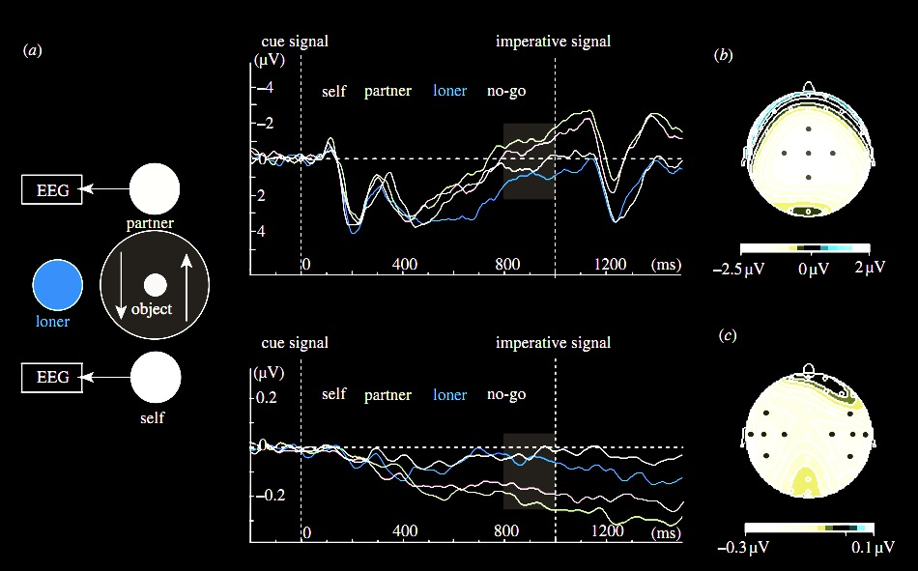
premise:
Social motor cognition enables joint action
Kourtis, Sebanz & Knoblich (2010)
Notes:
Here’s the experiment they did.
The task was simple: two people sat opposite each other. Sometimes they acted alone, picking up and replacing an object. And sometimes had to act together, passing an object between them. Also present was the ‘loner’ who always acted alone.

Slide 11
premise:
Social motor cognition enables joint action
Kourtis, Sebanz & Knoblich (2010)
Notes:
EEG measurements of motor activation were recorded.

Slide 12
premise:
Social motor cognition enables joint action
Kourtis, Sebanz & Knoblich (2010)

Slide 13
premise:
Social motor cognition enables joint action
Kourtis, Sebanz & Knoblich (2010)
Notes:
The researchers found that patterns of activation for self & joint action partner were similar, and different from patterns of activation for the actions of the loner which were similar to patterns in a ‘no go’ condition where no one was to act.

Slide 14
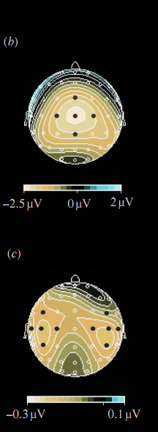
premise:
Social motor cognition enables joint action
Kourtis, Sebanz & Knoblich (2010)
Notes:
So here’s what I take from this paper.
If you are engaged in a joint action with someone, one which involves moving an object by passing it between you, then each of you has motor representations of the other’s actions and these motor representations are functionally equivalent to motor representations of your own actions in the sense that they are just the sorts of representation that might have caused you to do what the other is doing (if you were in her position).

Slide 15
premise:
Social motor cognition enables joint action
Kourtis, Sebanz & Knoblich (2010)
Notes:
Suppose that Kourtis et al are right that social motor representation is more likely to occur in joint action than when one is merely observing.
How could this facilitate joint action?

Slide 16
Move it from there to here
Notes:
Let’s step back and consider an individual action.
An agent moves a mug from one place to another, passing in from her left hand to her right hand half way [*demonstrate].
It’s a familiar idea that motor representations for planning and monitoring action involve an hierarchical structure,
where there is a relatively abstract representation of an outcome that is progressively filled in.

Slide 17
Move it from there to here
get it
move it
position it
hand-1
reach
grasp
move
arrive
release
hand-2
reach
grasp
move
place
release
Notes:
I don’t suppose that this attempt to depict the hierarchy of motor representations involved in moving a mug with two hands is accurate.
I’m only trying to illustrate two familiar ideas.
One is that motor planning involves starting with relatively abstract representations of outcomes and filling in details.

Slide 18
Move it from there to here
get it
move it
position it
hand-1
reach
grasp
move
arrive
release
hand-2
reach
grasp
move
place
release
Notes:
The other is that there is a need, even for a single agent, to synchronize the exchange between the two hands.
How is this relevant to the case of joint action?

Slide 19
joint action: same goal
Move it from there to here
get it
move it
position it
hand-1
reach
grasp
move
arrive
release
hand-2
reach
grasp
move
place
release
Notes:
In joint action the agents have the same goal, to move the object from there to here.

Slide 20
joint action: same goal
Move it from there to here
get it
move it
position it
hand-1
reach
grasp
move
arrive
release
hand-2
reach
grasp
move
place
release
similar timing problem
Notes:
They also face a similar coordination problem, requiring a precisely timed swap

Slide 21
joint action: same goal
Move it from there to here
get it
move it
position it
same planning
hand-1
reach
grasp
move
arrive
release
hand-2
reach
grasp
move
place
release
similar timing problem
Notes:
And Koutis et al’s findings (and others’ findings) suggest that the same planning in involved in the joint action case, almost up to the actual muscle contractions.
That is, in the joint action situation each agent plans both agents’ actions.
This may be what enables them to coordinate so well : each is able to plan her own actions in a way that meshes with the other agent’s actions because each agent is planning (and monitoring) both their actions almost as if she were going to execute each action.

Slide 22
joint action: same goal
Move it from there to here
get it
move it
position it
same planning
hand-1
reach
grasp
move
arrive
release
hand-2
reach
grasp
move
place
release
inhibition needed
similar timing problem
Notes:
So what is the difference between the individual and the joint case? From the point of view of motor representation, the primary difference may be that in joint action there is a need to inhibit execution of the parts of the action which are not one’s own.
Now so far I’ve only been considering a possible role for social motor representation in enabling joint action.
The idea is that coordination is sometimes achieved by having each agent’s motor system plan all of their actions;
given some assumptions, this could be a way of making it likely that each will execute their part in the joint action in a way that meshes with the way the other agents execute their parts.
If this is right, I think we should conclude that motor representation has a role to play in explaining what joint action is.
How does this work.
Let’s start with individual action again.

Slide 23
What is the relation between a purposive action and the outcome or outcomes to which it is directed?
out
action
out
act
out
out
Notes:
A basic question about ordinary, individual action is:
What is the relation between a purposive action and the outcome or outcomes to which it is directed?
Many ordinary purposive actions have many different outcomes.
Grabbing little Isabel by the hands I swing her around, causing her to laugh and, simultaneously, breaking a vase.
In fact the outcome to which this purposive action was directed might not be among its actual outcomes; after all, actions can fail.

Slide 24
What is the relation between a purposive action and the outcome or outcomes to which it is directed?
out
action
out
out
act
out
out
Notes:
So among all the actual and possible outcomes of my action, one or some are singled out as specially related to this action.
One aspect of the question concerns what singles out the outcome or outcomes, actual or merely possible, to which a particular purposive is directed.
But there is also a second aspect ...

Slide 25
What is the relation between a purposive action and the outcome or outcomes to which it is directed?
wave
out
action
out
reach
act
out
grasp
out
scratch
Notes:
Ordinary purposive actions are sometimes composed of more than one motor action. My swinging Isabel around starts with my reaching for her wrists, grasping them and then spinning us around ... and my action doesn’t include other things which I might be doing simultaneously, like refusing a cup of tea with my eyes or trying to determine whether that smell is coming from Isabel’s sister Hannah’s nappy.

Slide 26
What is the relation between a purposive action and the outcome or outcomes to which it is directed?
wave
out
action
out
reach
act
out
grasp
out
scratch
Notes:
So another aspect of our question is what determines which activities comprise the purposive action and which do not.

Slide 27
What is the relation between a purposive action and the outcome or outcomes to which it is directed?
wave
out
action
out
reach
act
out
grasp
intention or motor representation
out
scratch
Notes:
The standard answer to this question involves intention.
An intention (1) represents an outcome, (2) coordinates the one or several activities which comprise the action; and (3) coordinate these activities in a way that would normally facilitate the outcome’s occurrence.
So the intention is what binds activities into purposive actions and links actions to the outcomes to which they are directed.

Slide 28
What is the relation between a purposive action and the outcome or outcomes to which it is directed?
wave
out
action
out
reach
act
out
grasp
intention or motor representation
out
scratch
Notes:
Now as Elisabeth Pacherie has argued (and I’ve had a go at this argument in joint work with Corrado Sinigaglia recently too),
motor representations are relevantly similar to intentions.
Of course motor representations differ from intentions in some important ways (as Pacherie also notes).
But they are similar in the respects that matter for explaining the purposiveness of action.
(1) Like intentions, some motor representations represent outcomes (and not merely patters of joint displacement, say).
(2) Like intentions, some motor representations play a role in coordinating multiple more component activities.
(3) And like intentions, some motor representations coordinate these activities in a way that would normally facilitate the outcome’s occurrence.
So in the individual case, it seems to me quite straightforward that there is a role for motor representation to play in explaining the purposiveness of action [*explaining the possibility of purposive action?].
The claim is not that \emph{all} purposive actions are linked to outcomes by motor representations, just that some are.

Slide 29
What is the relation between a purposive action and the outcome or outcomes to which it is directed?
wave
out
action
out
reach
act
out
grasp
intention or motor representation
out
scratch
Notes:
Now let’s turn to joint action.

Slide 30
joint
What is the relation between a purposive action and the outcome or outcomes to which it is directed?
wave
out
action
out
reach
act
out
grasp
intention or motor representation
out
scratch
Notes:
The same question we asked about ordinary, individual action also arises for joint action.
What is the relation between a purposive joint action and the outcome or outcomes to which it is directed?

Slide 31
joint
What is the relation between a purposive action and the outcome or outcomes to which it is directed?
out
joint
action
out
act
out
out
Notes:
And again the question has two aspects.
What singles out the outcome or outcomes to which a purposive joint action is directed?

Slide 32
joint
What is the relation between a purposive action and the outcome or outcomes to which it is directed?
wave
out
joint
action
out
reach
act
out
grasp
out
scratch
Notes:
And what binds together the various activities that make up the joint action?
The difference in the case of joint action is, of course, that these activities are not necessarily activities of a single agent.

Slide 33
joint
What is the relation between a purposive action and the outcome or outcomes to which it is directed?
wave
out
joint
action
out
reach
act
out
grasp
shared intention or motor representation
out
scratch
Notes:
The answer to this question for the case of joint action is also superficially similar in the answer we gave in the case of ordinary, individual action.
A shared intention is what relates purposive joint actions to the outcomes to which they are directed.
For the shared intention
(1) involves a representation, on the part of each agent, of an outcome
(2) coordinates the several agents’ activities
and
(3) coordinates the several agents’ activities in such a that would normally facilitate the occurrence of the represented outcome.
It is in this sense that a shared intention can ground the purposiveness of a joint action.

Slide 34
joint
What is the relation between a purposive action and the outcome or outcomes to which it is directed?
wave
out
joint
action
out
reach
act
out
grasp
shared intention or motor representation
out
scratch
Notes:
But what we saw earlier, what the research by Kourtis et al and others indicates, is that social motor representation can play a similar role to joint action.
Return to the example of a two agents moving an object in a way that involves passing it between them.
the motor representation
(1) involves a representation, on the part of each agent, of an outcome
In this case the outcome is the whole movement of the object
(2) coordinates the several agents’ activities
and
(3) coordinates the several agents’ activities in such a that would normally facilitate the occurrence of the represented outcome.
Because each agent represents the whole movement and plans all of its implementation irrespective of which parts she will actually perform, each agent plans the action in a way that should coordinate with the other agent’s plans providing they use similar planning procedures
[*What I’m saying here, in effect, is that both shared intention and social motor representation can yeild a COLLECTIVE GOAL]

Slide 35
joint
What is the relation between a purposive action and the outcome or outcomes to which it is directed?
wave
out
joint
action
out
reach
act
out
grasp
shared intention or motor representation
out
scratch
Notes:
What I’m suggesting is very simple.
If you think that in ordinary, individual action, the purposiveness of actions can be grounded by motor representations
(and you should think this because it’s true),
then you should also think the same about actions involving two or more agents---the purposiveness of a joint action can be grounded in motor representations as well as in shared intentions.

Slide 36

Sufficient conditions
We have a shared intention that we J if
“1. (a) I intend that we J and (b) you intend that we J
“2. I intend that we J in accordance with and because of la, lb, and meshing subplans of la and lb; you intend [likewise] …
“3. 1 and 2 are common knowledge between us”
(Bratman 1993: View 4)
Notes:
Here are Michael Bratman’s sufficient conditions for shared intention.
I want to suggest that social motor representation provides a parallel

Slide 37
Sufficient conditions
We have a shared intention that we J if
“1. (a) I intend that we J and (b) you intend that we J
“2. I intend that we J in accordance with and because of la, lb, and meshing subplans of la and lb; you intend [likewise] …
“3. 1 and 2 are common knowledge between us”
(Bratman 1993: View 4)
Notes:
There is a direct parallel with the first condition: in the case of motor representation, each agent represents the outcome (e.g. the movement of the object)

Slide 38
Sufficient conditions
We have a shared intention that we J if
“1. (a) I intend that we J and (b) you intend that we J
“2. I intend that we J in accordance with and because of la, lb, and meshing subplans of la and lb; you intend [likewise] …
“3. 1 and 2 are common knowledge between us”
(Bratman 1993: View 4)
Notes:
Here there is clearly no \emph{direct} parallel.
I don’t think motor representations can represent motor representations in the way that intentions can represent intentions.
But I do think there is a parallel of sorts.
For motor planning is set up in such a way that execution of all component actions will mesh.
So in the case where joint actions is grounded in social motor representation, what ensures (if anything ensures) meshing of subplans is not the fact that each agent represents the others’ plans but these facts (i) each agent plans all of the agents’ actions, and (ii) the agents rely on similar planning strategies (planning strategies that are sufficiently similar to ensure meshing subplans).

Slide 39
Sufficient conditions
We have a shared intention that we J if
“1. (a) I intend that we J and (b) you intend that we J
“2. I intend that we J in accordance with and because of la, lb, and meshing subplans of la and lb; you intend [likewise] …
“3. 1 and 2 are common knowledge between us”
(Bratman 1993: View 4)
Notes:
I’m less sure about a parallel to the common knowledge condition,
but one thing that might do the work of common knowledge is a custom or habit
that would allow the agents, in their particular social context, to rely on each other’s cooperation.
In some countries this sort of thing works on public transport;
it is reasonable to take for granted that, if you are obviously struggling with a pram or suitcase, then someone nearby will help.

Slide 40
Sufficient conditions
We have a shared intention that we J if
“1. (a) I intend that we J and (b) you intend that we J
“2. I intend that we J in accordance with and because of la, lb, and meshing subplans of la and lb; you intend [likewise] …
“3. 1 and 2 are common knowledge between us”
(Bratman 1993: View 4)
Notes:
If this is right, if social motor representations play a role analogous to the structure of intentions and knowledge which Bratman identifies as sufficient for shared intention, then this is another reason to think that motor representations can ground the purposiveness of joint action.

Slide 41
premise:
Social motor representation enables joint action
question:
Does social motor representation also play a role in explaining what joint action is? [Yes]
challenge:
How could social motor representation and shared intention harmoniously contribute to joint action?
Notes:
Recap: the question was:
Does social motor representation also play a role in explaining what joint is?
I have just been arguing for a positive answer.
A positive answer implies that \emph{there could be purposive joint actions which do not involve shared intentions},
just as there can be purposive actions which do not involve intentions at all.
Let me go slowly here and focus on the individual case.

Slide 42
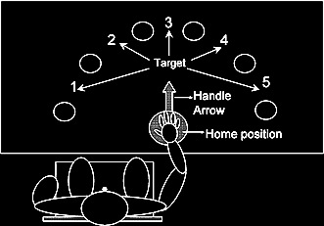
(Zhang and Rosenbaum 2007)
Notes:
Motor representations enable quite sophisticated planning over short periods of time and sequences of action; for example, how you grasp a pointer will depend on what you are about to do with it \citep{zhang:2007_planning}.
This sort of planning does not need intentions at all. So what are intentions for?

Slide 43
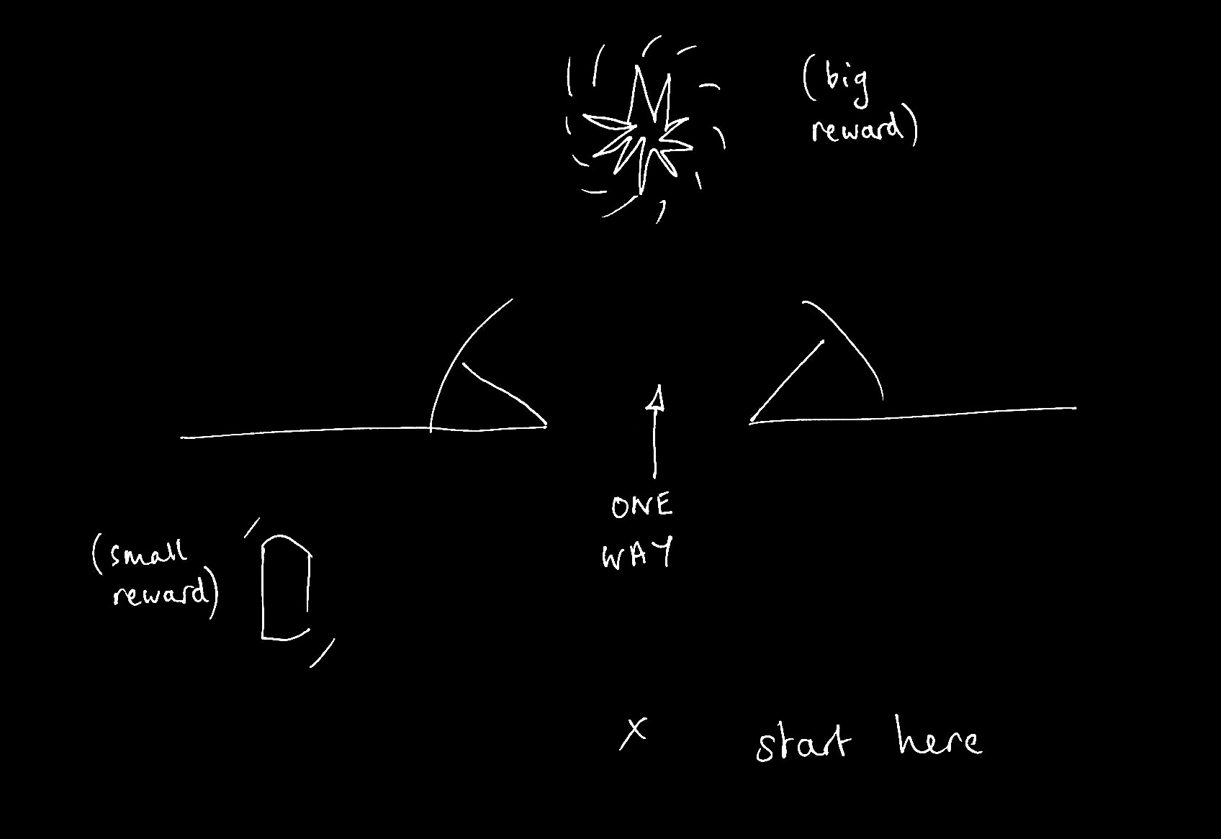
Notes:
Intentions are for planning multiple separate actions over longer periods of time.
This is a case where intentions are really needed --- can’t act on strongest desire (for the big reward) if want to maximise rewards by collecting the small and the large reward.
Intentions are for planning [*not sure exactly how to work this in : the point is that not all actions involve intention]
Not all purposive actions involve any planning of this sort. You offer me a biscuit. I want one, and I believe I can get one by reaching out for it. So I do. There’s no need to suppose that, in addition to the belief and desire, it must be the case that I also intend to take a biscuit. Maybe I do intend this. But it’s possible for an agent to take and eat a biscuit, and to do so purposively, without having any intentions at all. Beliefs desires and motor representations are sufficient.
Now you could imagine a two-person version of this task where we are rewarded for what we collectively achieve. In this case it’s optimal if one of us goes for the small reward and the other goes for the large reward. I think it’s this kind of planning that shared intention is really for.
I’m suggesting that some joint actions---like the one two people move an object in a way that involves passing it between them---don’t require this kind of planning and so don’t necessarily involve shared intentions.
In some cases, social motor representation alone is sufficient for purposive joint action.

Slide 44
‘I take a collective action to involve a collective [shared] intention.’
(Gilbert 2006, p. 5)
‘The sine qua non of collaborative action is a joint goal [shared intention] and a joint commitment’
(Tomasello 2008, p. 181)
‘the key property of joint action lies in its internal component [...] in the participants’ having a “collective” or “shared” intention.’
(Alonso 2009, pp. 444-5)
‘Shared intentionality is the foundation upon which joint action is built.’
(Carpenter 2009, p. 381)
Notes:
This goes against a widely shared view in the literature

Slide 45
‘I take a collective action to involve a collective [shared] intention.’
(Gilbert 2006, p. 5)
‘The sine qua non of collaborative action is a joint goal [shared intention] and a joint commitment’
(Tomasello 2008, p. 181)
‘the key property of joint action lies in its internal component [...] in the participants’ having a “collective” or “shared” intention.’
(Alonso 2009, pp. 444-5)
‘Shared intentionality is the foundation upon which joint action is built.’
(Carpenter 2009, p. 381)
Notes:
To focus on just one case, Alonso says ‘the key property of joint action lies in its internal component [...] in the participants’ having a “collective” or “shared” intention.’
(Alonso 2009, pp. 444-5)
I want to spend a bit of time on this claim because it matters for my second theme, which is a problem concerning how motor representation and shared intention interface in joint action.
As far as I know, this claim is not explicitly argued for. From conversation with philosophers I think the central argument is supposed to contrast cases.
Contrast cases are pairs of actions which are similar in terms of behaviour and coordination but where one is joint but the other isn’t....

Slide 46
Joint
Not joint

Slide 47
Joint
Not joint
Jack and Sue walk together
Jack and Sue walk alongside each other
(Gilbert 1990)
Notes:
for example ...

Slide 48
Joint
Not joint
Jack and Sue walk together
Jack and Sue walk alongside each other
(Gilbert 1990)
We collectively perform a dance by running to a shelter at the same time
We each individually run to a shelter at the same time (in response to a sudden shower).
(Searle 1990, 92)
Notes:
These sorts of contrast case invite the question, How do joint actions differ from individual actions which may occur in parallel? What is the difference between Jack & Sue walking together and their walking side-by-side? Gilbert’s example shows that the difference can’t just be a matter of coordination, because people merely walking alongside each other also need to coordinate their actions in order to avoid colliding with each other. And Searle’s example shows that the difference between joint action and parallel individual action can’t just be that the actions have a common effect because merely parallel actions can have common effects too.
How might this lead someone to think that all joint action involves shared intention?
I think the idea is supposed to be this.
One difference between the genuinely joint actions and their merely parallel counterparts is that the genuinely joint actions involve shared intentions.
And there is no further difference that enables one, systematically to distinguish the two cases.
I think this argument is mistaken.
First because there are contrast cases in which the joint action does not involve shared intention (Ayesha & Beatrice lifting (i) as originally described [not joint] and (ii) involving reciprocal social motor representation.
It follows that appeal to shared intention does not provide a sufficiently general way of explaining the difference illustrated by the contrast cases.
Second because there is a more general notion appeal to which enables us to distinguish the contrast cases.
Genuine joint action differs from merely parallel action because the former involves each agent’s representing an outcome to which all of their actions are directed where these outcome representations coordinate their actions in a way that would normally facilitate their collective success in bring about this outcome.
(Actually I don’t think this is quite general enough because I think there some joint actions involve non-representational coordinative structures only, but I don’t want to get into that here. It’s sufficient that we have moved away from the bare shared intention account.)
To sum up so far, I reject the claim that reflection on the contrast cases provides any support for the idea that all joint action involves shared intention.

Slide 49
premise:
Social motor representation enables joint action
question:
Does social motor representation also play a role in explaining what joint action is? [Yes]
challenge:
How could social motor representation and shared intention harmoniously contribute to joint action?
‘the key property of joint action lies in its internal component [...] in the participants’ having a “collective” or “shared” intention.’
(Alonso 2009, pp. 444-5)
Notes:
So far I have been assuming that there is an inconsistency between two claims:
(1) my claim that social motor representation can ground purposive joint action
(2) many philosophers’ claim that all joint actions involve shared intention.
But maybe it is a mistake to think that these are inconsistent.
Why not suppose that some social motor representations are a variety of shared intentions?
I want to pursue this issue. It might initially seem narrowly conceptual or terminological. But it matters for understanding the interface between shared intention and motor representation.
At the end of the day it doesn’t much matter if we want to call some motor representations ‘shared intentions’. After all, on most accounts shared intentions are neither shared nor intentions so we would hardly be doing more violence to the term than is already being done.
However, there are some important differences between the states normally regarded as shared intentions and any motor representations.
First point:
It does require re-thinking notion of joint action for the three assumptions from Instrumentalism are not met
Second point:
Difference in format.

Slide 50
awareness of joint-ness
at least one of the agents knows that they are not acting individually; she or they have ‘a conception of themselves as contributors to a collective end.’
awareness of others’ agency
at least one of the agents is aware of one or more of the others as an intentional agent.
awareness of others’ states or commitments
at least one of the agents who are F-ing is aware of, or has individuating beliefs about, some of the others’ intentions, beliefs or commitments concerning F.

Slide 51
awareness of joint-ness
at least one of the agents knows that they are not acting individually; she or they have ‘a conception of themselves as contributors to a collective end.’
awareness of others’ agency
at least one of the agents is aware of one or more of the others as an intentional agent.
awareness of others’ states or commitments
at least one of the agents who are F-ing is aware of, or has individuating beliefs about, some of the others’ intentions, beliefs or commitments concerning F.

Slide 52
awareness of joint-ness
at least one of the agents knows that they are not acting individually; she or they have ‘a conception of themselves as contributors to a collective end.’
awareness of others’ agency
at least one of the agents is aware of one or more of the others as an intentional agent.
awareness of others’ states or commitments
at least one of the agents who are F-ing is aware of, or has individuating beliefs about, some of the others’ intentions, beliefs or commitments concerning F.

Slide 53
awareness of joint-ness
at least one of the agents knows that they are not acting individually; she or they have ‘a conception of themselves as contributors to a collective end.’
awareness of others’ agency
at least one of the agents is aware of one or more of the others as an intentional agent.
awareness of others’ states or commitments
at least one of the agents who are F-ing is aware of, or has individuating beliefs about, some of the others’ intentions, beliefs or commitments concerning F.

Slide 54
awareness of joint-ness
at least one of the agents knows that they are not acting individually; she or they have ‘a conception of themselves as contributors to a collective end.’
awareness of others’ agency
at least one of the agents is aware of one or more of the others as an intentional agent.
awareness of others’ states or commitments
at least one of the agents who are F-ing is aware of, or has individuating beliefs about, some of the others’ intentions, beliefs or commitments concerning F.

Slide 55
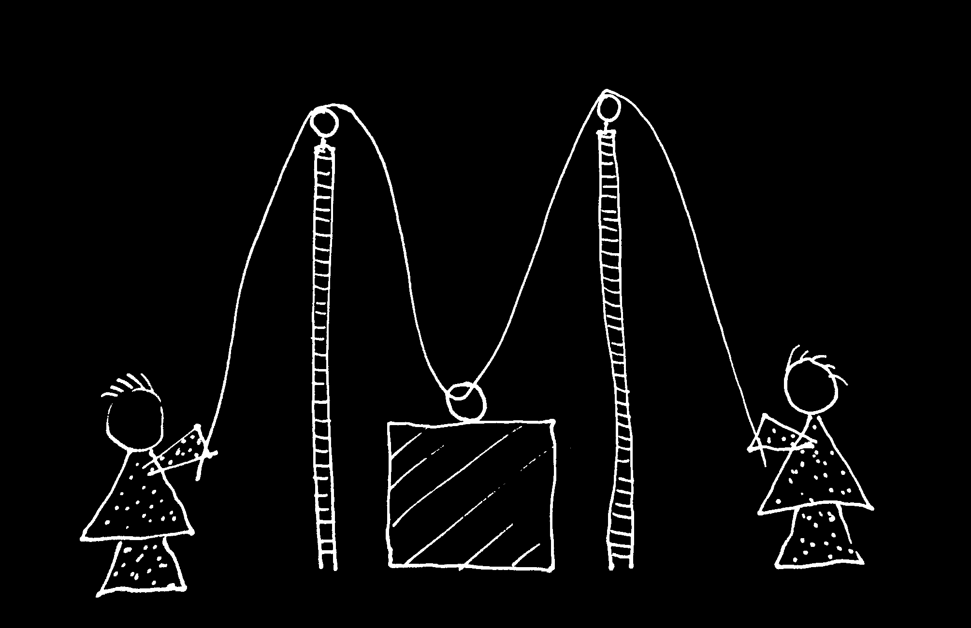
cf. Vesper et al (forthcoming)
Notes:
[***This is here because I might just use it to give a contrast case involving social motor repn: (1) parallel = as originally described; (2) joint = their motor systems perceive or imagine each other’s action through the rope and plan accordingly. Maybe this is not very convincing]

